Slide 1
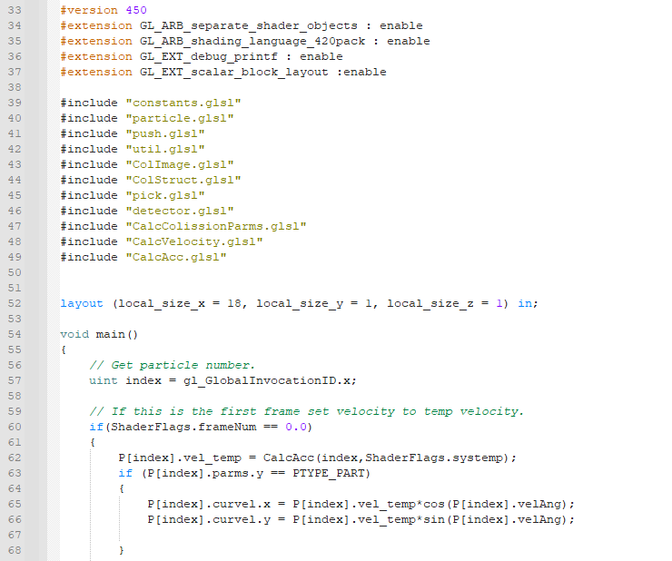


Rounded Cell Collision Detection Dynamics
Jack Bell

Slide 2
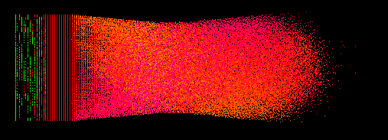
Agenda
Intro
Current Status
Goals
Resources
SUMMARY

Slide 3
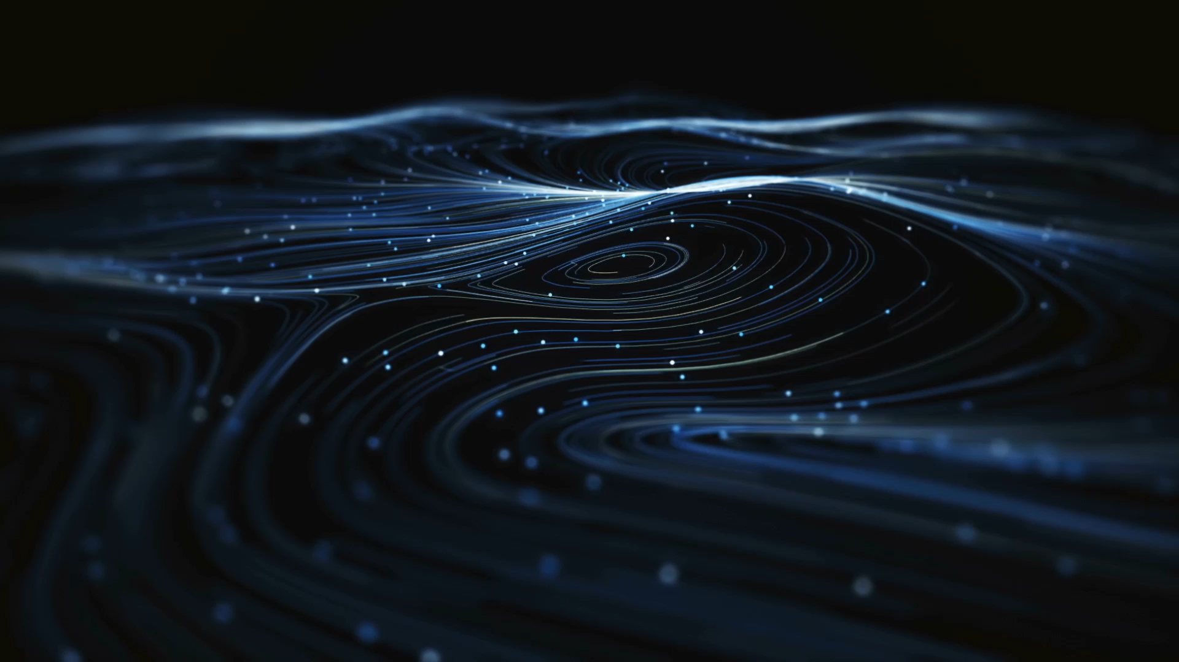
Current Status
Rounded Cell Collision Detection on the GPU.
Can still increase parallelism.
Novelty?
At least a complete rethink of CD in the current GPU-Driven environment.

Slide 4
Intro
Rounded Cell Collision Detection.
Three planned papers
(1) RCCD on the GPU
Near complete
(2) RCCD Dynamics
In process
(3) RCCD Real Gasses
Planned

Slide 5
Current Status
Rounded Cell Collision Detection dynamics (Paper 1).
Need to test and add section on different types of duplications
Need to make it fully parallel in both compute and graphics pipelines.
Need to test on more machines.

Slide 6
Current Status
Rounded Cell Collision Detection dynamics (Paper 2).
80% done with elastic collisions for solids.
Need inelastic collisions for gases.
Need repulsion and attraction for phase change.

Slide 7
Current Status
Demonstration
Simulation Setup
Speed calculations.
Simple Flow
Boundary (on off)
Slice
Evaluate Main Dialog
Evaluate Gradient plot

Slide 8
Current Status
Why do we need really fast collision detection?
There are speed limits..
How many frames are need for the particles to overlap?
For inelastic collisions, particles need to overlap for a sufficient period of time.
Bonding phase change, temperature, pressure, attract, repulsion.
Requires small dt so we need more frames per second to have realtime movement.

Slide 9

Goals For Next Semester
Plan for Fall 2024.
Be in PhD program before end of this semester (Aug. 8).
Finish paper 1 and get submit it to journal.
Apply for outside financial support.
A working system with a great deal of research and work already done.

Slide 10
Resources Needed
Physical
4 other platforms (CPU-Nvidia GPU) to record performance tests for paper 1.
Help and advice getting published.
Starting at the top…

Slide 11
Summary
I think this is a novel system, at least a rethink oF CD in the current GPU-Driven environment.
It is at least worth the risk of continuing development.

Slide 12
Done…
FIN

